Slide 1
Summary: The following slides may be leveraged to present the History of the Framework, beginning with Executive Order 13636, publication of Framework v1.0, and ending with the creation of the v1.1 update.
Audience: These slides are intended for an audience who is new to the Framework and seeking to understand its history.
Learning Objectives:
Identify the catalyst that led to the creation of the Framework (Executive Order 13636)
Recognize the public-private collaboration that led to the creation of the Framework
Awareness of the continued improvement activities including v1.1 of the Framework

Slide 2

History & Development
of the Framework
July 2018
cyberframework@nist.gov

Slide 3
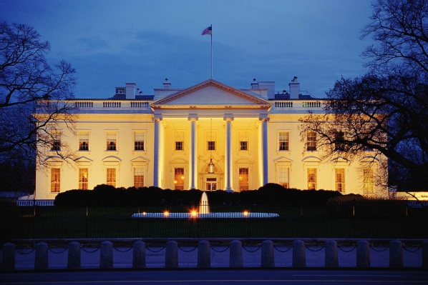
Improving Critical Infrastructure Cybersecurity
“It is the policy of the United States to enhance the security and resilience of the Nation’s critical infrastructure and to maintain a cyber environment that encourages efficiency, innovation, and economic prosperity while promoting safety, security, business confidentiality, privacy, and civil liberties”
Executive Order 13636
February 12, 2013
Notes:
The Framework for Improving Critical Infrastructure Cybersecurity (“The Framework”) originates with an executive order (EO) from the Obama era, EO13636. NIST was tasked with creating a framework to reduce critical infrastructure (CI) risk.

Slide 4
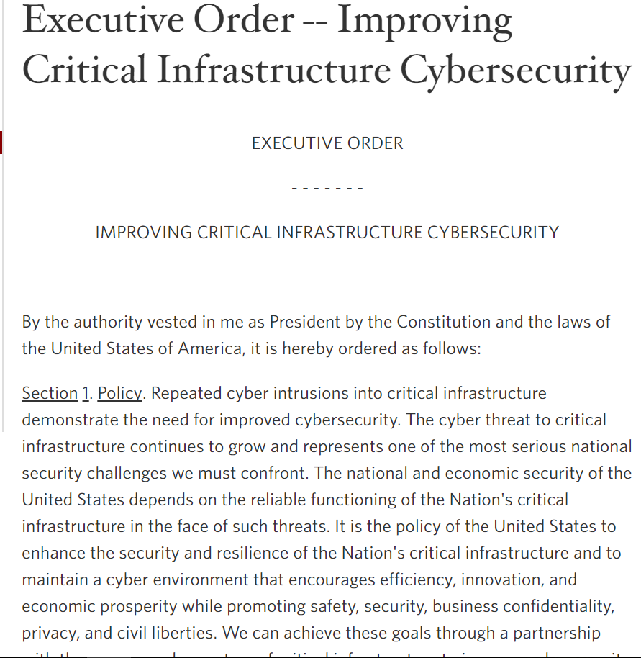
Creating the Cybersecurity Framework
The Executive Order acted as design criteria for creating the Framework
Notes:
These are paraphrased cuts from that executive order. They were used as the design criteria when moving forward with the creation of the Framework.
Includes a set of standards, methodologies, procedures, and processes that align policy, business, and technological approaches to address cyber risks.
Provides a prioritized, flexible, repeatable, performance-based, and cost-effective approach, including information security measures and controls, to help owners and operators of critical infrastructure identify, assess, and manage cyber risk.
Identifies areas for improvement to be addressed through future collaboration with particular sectors and standards-developing organizations.
Is consistent with voluntary international standards.

Slide 5
Development of the Framework
Engage Stakeholders
Analyze RFI Responses
Identify Framework Elements
Collect, Categorize, Post RFI Responses
Prepare and Publish Framework
EO 13636 Issued – Feb 12, 2013
RFI Issued – Feb 2013
1st Workshop – April 2013
Completed – April 2013
2nd Workshop – May 2013
Draft Outline of Framework – June 2013
3rd Workshop – July 2013
4th Workshop – Sept 2013
Ongoing Engagement:
Open public comment/ review encouraged throughout the process…
and to this day
5th Workshop – Nov 2013
Published – Feb 12, 2014
Notes:
Rather than develop the Framework behind closed doors, NIST engaged heavily with critical infrastructure owners, operators, and other industry folk to get input.
The process began with a public Request for Information (RFI) to see what would be valuable to see in a cybersecurity framework for critical infrastructure. After the RFI, workshops were held throughout the country to gather more feedback. A draft outline was published and another Request for Comment took place. All of this feedback was analyzed and had major impact on the direction and content of the Framework.
NIST continues this public-private partnership through open and ongoing conversations with industry. NIST is always seeking additional feedback regarding the Framework at cyberframework@nist.gov.

Slide 6
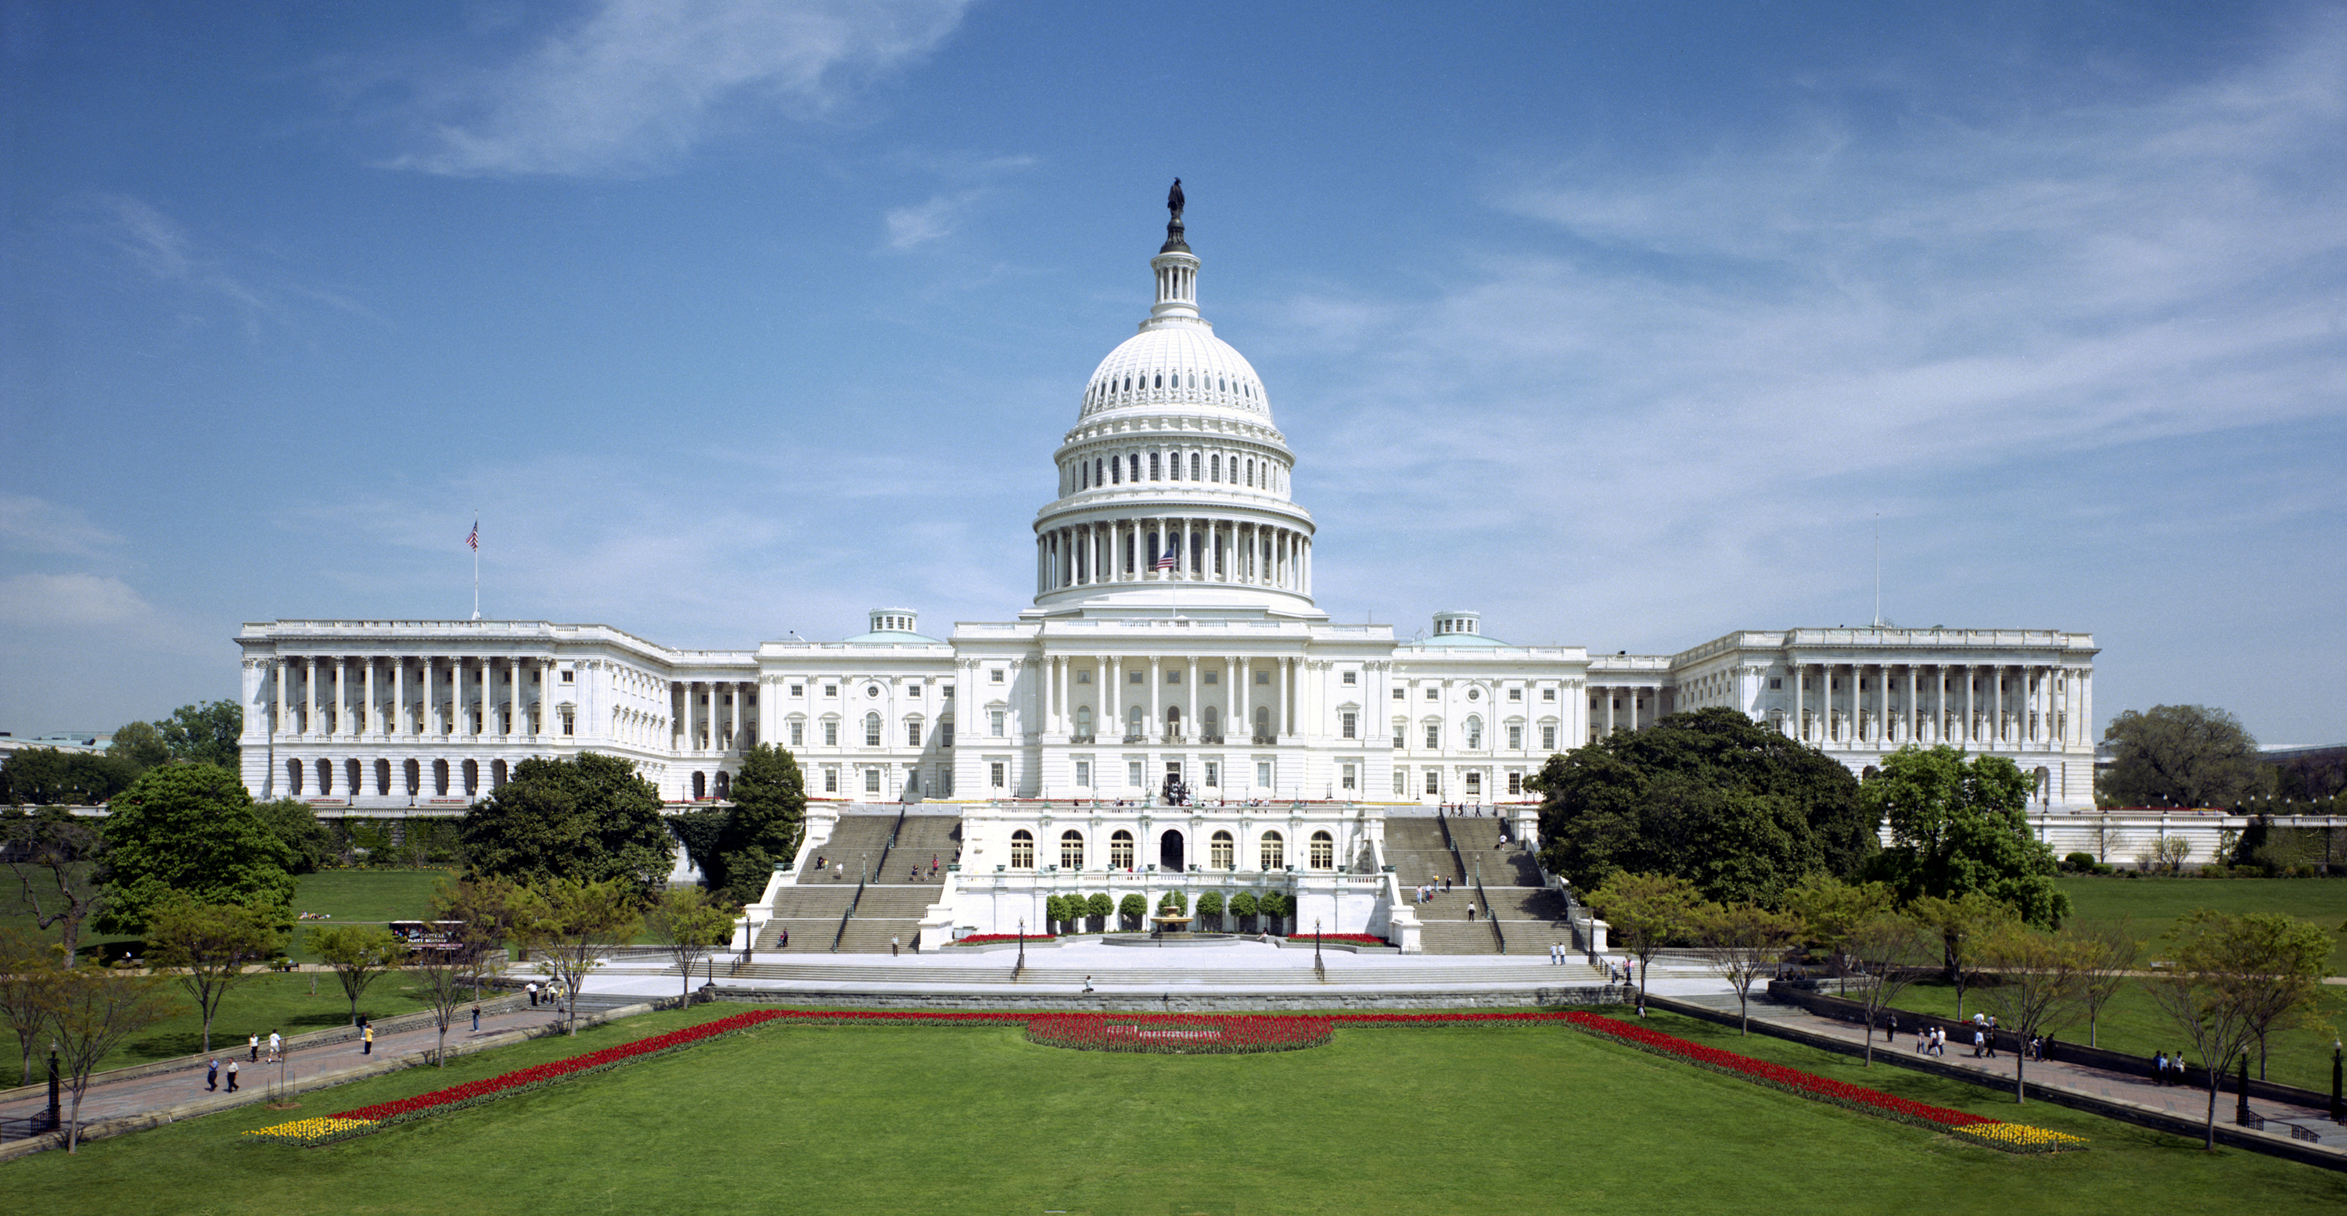
Continued Improvement
Amends the National Institute of Standards and Technology Act (15 U.S.C. 272(c)) to say:
“…on an ongoing basis, facilitate and support the development of a voluntary, consensus-based, industry-led set of standards, guidelines, best practices, methodologies, procedures, and processes to cost-effectively reduce cyber risks to critical infrastructure”
Cybersecurity Enhancement Act of 2014
(P.L. 113-274)
18 December 2014
Notes:
The charter for the past was EO 13636, and the charter for the future will be the Cybersecurity Enhancement Act of 2014. Went into effect in December 2014.
This excerpt highlights the call for ongoing evolution and development over time. Once again, with collaboration from industry. This manifests itself in the publication of Framework version 1.1 and any future updates.

Slide 7
Continued Improvement
Update Activities | Engagement
Request for Information – Views on the Framework for Improving Critical Infrastructure Cybersecurity – Dec 2015 | 105 Responses
7th Workshop – Apr 2016 | 653 Physical Attendees, 140 Online Attendees
Draft 1 – Framework Version 1.1 – Released Jan 2017 | -
Request for Comment – Proposed update to the Framework for Improving Critical Infrastructure Cybersecurity – Jan 2017 | 129 Responses
Draft 2 – Framework Version 1.1 – Released Dec 2017 | -
8th Workshop – May 2017 | 517 Physical Attendees, 1528 Online Attendees
Request for Comment – Cybersecurity Framework Version 1.1 – Draft 2 – Dec 2017 | 89 Responses
Framework Version 1.1 – Released April 2018 | -

Slide 8
Resources Where to Learn More and Stay Current
Framework for Improving Critical Infrastructure Cybersecurity and related news, information:
www.nist.gov/cyberframework
Additional cybersecurity resources: http://csrc.nist.gov/
Questions, comments, ideas: cyberframework@nist.gov

